Slide 1
Chemical Ideas 7.6
Chromatography

Slide 2
The general principle.
Use – to separate and identify components of mixtures.
Several different types - paper, thin layer, gas-liquid.
All use the principle of “partition” - affinity between two phases, to separate mixtures of substances.
Stationary phase & mobile phase.
Compounds with greatest affinity for mobile phase travel further.

Slide 3
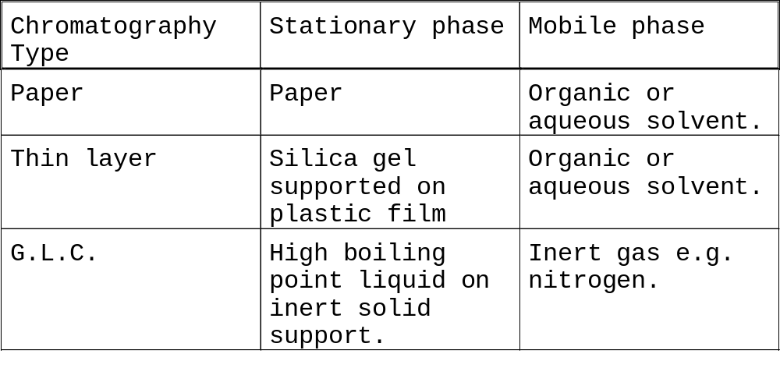
All chromatography needs:
support material – stationary phase
solvent (or carrier gas) – mobile phase.

Slide 4
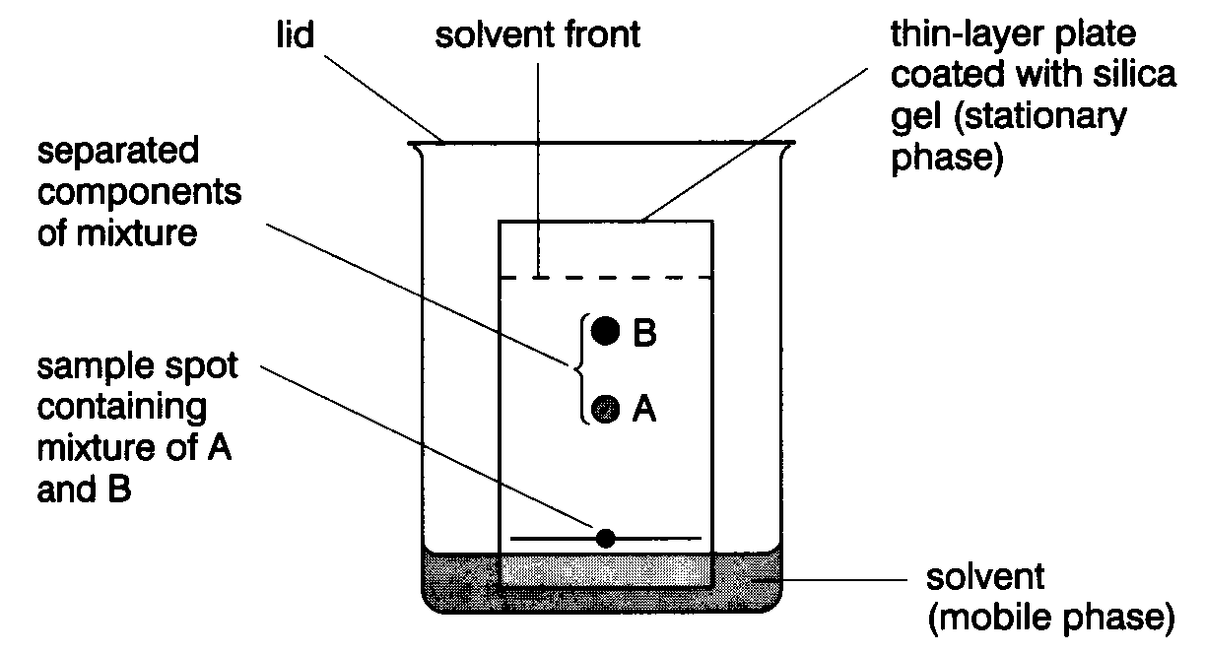
Thin Layer Chromatography - t.l.c.
Series of spots forms
Compare samples in mixture with known substances.
Measure R_{f} values.
Coloured compounds & colourless compounds.

Slide 5
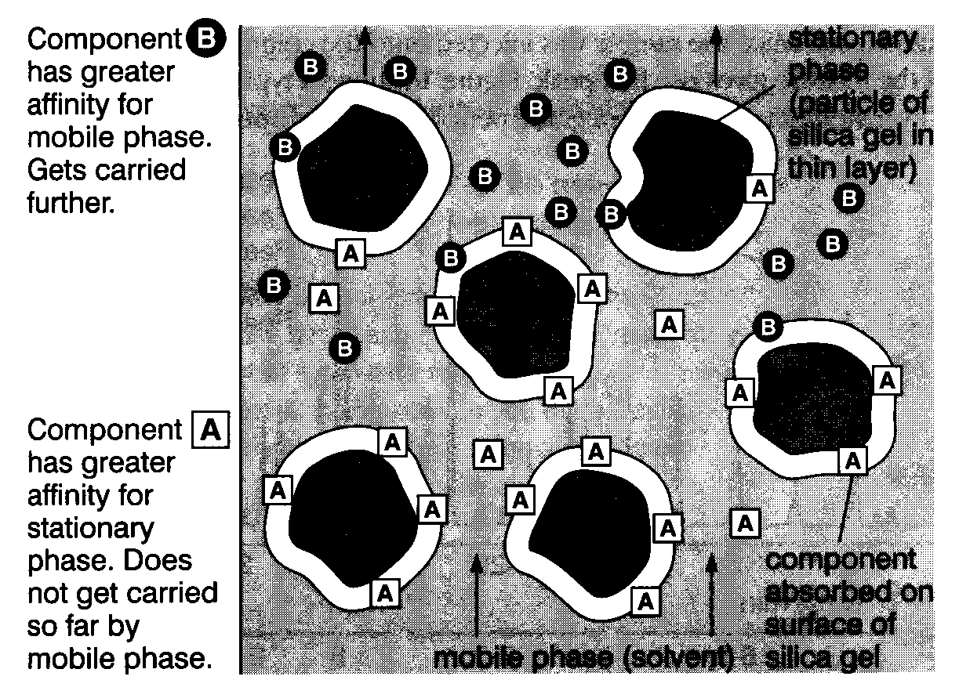
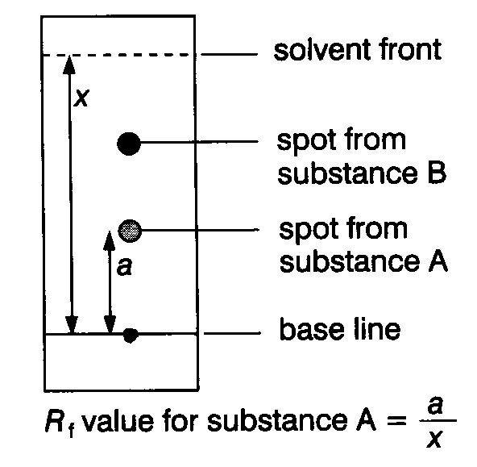
Separation and identification.

Slide 6
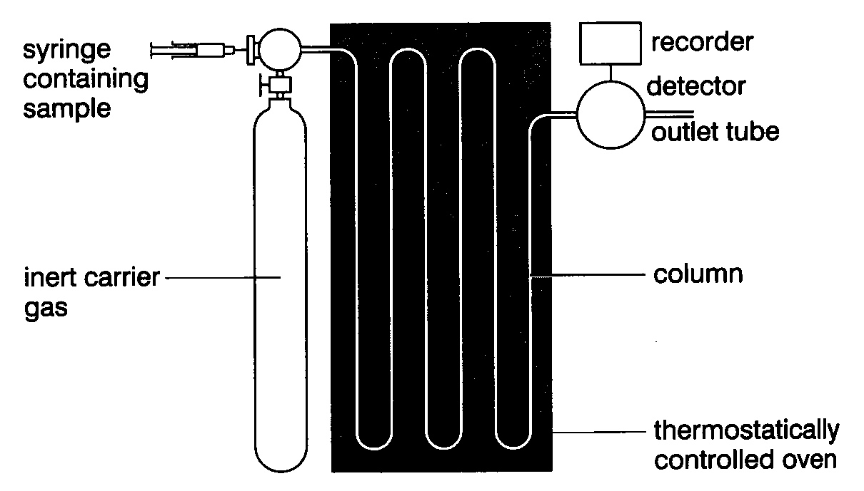
Gas - Liquid Chromatography G.l.c.
Sample introduced by syringe.
Column separates components.
(Heated in oven)
Detector monitors compounds emerging from outlet.
Recorder plots signals as a chromatogram.

Slide 7
What happens in practice.
Compounds that have high affinity for mobile phase emerge first, (most volatile).
Chromatogram charts recorder response against time.
Each component - separate peak.
Retention time – characteristic of the compound under given conditions.

Slide 8
Factors affecting retention time:
length of column
packing material
type of carrier gas
flow rate of carrier gas
temperature of column.

Slide 9
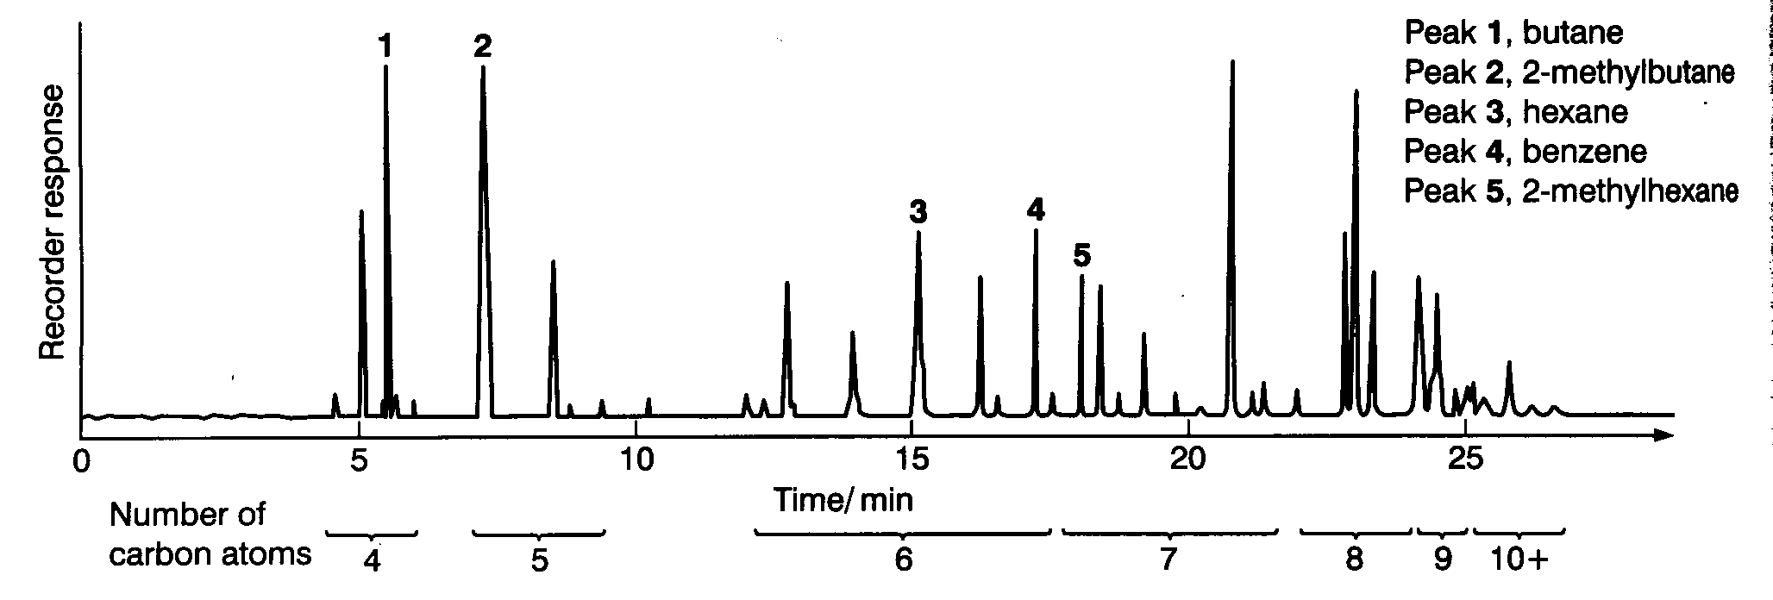
Interpreting the trace
Calibration – known compounds are added to the column and conditions kept constant.
Amount of substance – area under peak / peak height.
Relative proportions can be determined.

Slide 10
Uses of G.l.c.
Very sensitive - small quantities of substances detected, explosives, drugs etc.
Separation of pure substances for collection.
Can be connected to mass spectrometer for direct identification of substances.

Slide 11
This powerpoint was kindly donated to www.worldofteaching.com
http://www.worldofteaching.com is home to over a thousand powerpoints submitted by teachers. This is a completely free site and requires no registration. Please visit and I hope it will help in your teaching.

